Slide 1

Pacu
The Open Source AWS Exploitation Framework
Spencer Gietzen Rhino Security Labs

Slide 2

Intro
Who am I?
Penetration Tester
Focus on the cloud/AWS
Lead developer of Pacu
Why am I here?
AWS security and penetration testing
Pacu

Slide 3



AWS Security
Easy to get started, hard to master
Lots of good resources
Difficult to know if you are “doing it right”
Even the best mess it up
Uber – GitHub repo misconfig
Tesla – Unsecured IT admin console
Accenture (+1000s of others) – S3 bucket misconfig

Slide 4

The real threat
Authenticated Compromise
Far more devastating losing AWS keys
How do keys get leaked?
GitHub commits
Social engineering/phishing
Password reuse
Web application vulnerabilities:
Server-side request forgery
Local file read (through any method)
Internal threats/rogue employees

Slide 5
Pentesting AWS
Configuration scanning for best practices is one thing…
Lots of great tools to identify misconfigurations
Not much for attackers though…
Some helpful tools and scripts exist
Something more is needed though
Also hard to learn without practice
And it’s hard to practice without a target lab environment
You shouldn’t have to worry about:
Deploying AWS resources
(Mis)configuration of those resources
High cost
If only we had something like WebGoat…

Slide 6

Cloudgoat
A vulnerable-by-design AWS environment
Built to enable AWS security education
Deployed on-demand with Terraform
Integrates 9 commonly-misconfigured AWS services
IAM
CloudTrail
GuardDuty
EC2
CodeBuild
Lambda
Lightsail
S3
Glue

Slide 7
Cloudgoat (cont.)
Wide range of vulnerabilities
Multiple starting points (users or instances)
20+ attack vectors, including:
Privilege escalation
Disruption of logging/monitoring
Data enumeration and exfiltration
Persistence
Inexpensive
Approximately $1 to $3 a day, based on use
Safe
Whitelisted IP for ingress traffic rules
Not recommended to deploy alongside existing resources though
Open sourced on GitHub with BSD-3 license

Slide 8


Slide 9
What is next?
We have a target environment, but we are still missing something…

Slide 10
What is the need
Simple
Complex, multi-step attacks → just a couple commands
Unnecessary/repetitive code taken out of the developers hands
Future Proof
Modular to allow scripts to work with one another
Extensible to grow with AWS
Offensive Focused
There are already “Nessus of the cloud” tools, but we need “Metasploit”

Slide 11

The solution: Pacu
An Offensive AWS Exploitation Framework
Python3
Covers the kill chain
Simple module development
Use the built-in template to get started
Extensible
Built-in API to assist development
Session and data management
Error handling
Open sourced on GitHub
BSD-3 license

Slide 12
Pacu and Cloudgoat
Built with each other in mind
Many Pacu exploits match CloudGoat vulnerabilities
They will grow together as well
Great practice for new modules and techniques

Slide 13
Time for a demo
The Plan: Post-Compromise
Starting with compromised AWS keys
Using the Pacu console
Enumerating permissions, settings, and data
Escalating privileges
Establishing persistence
Backdooring security groups
Compromising EC2 instances

Slide 14
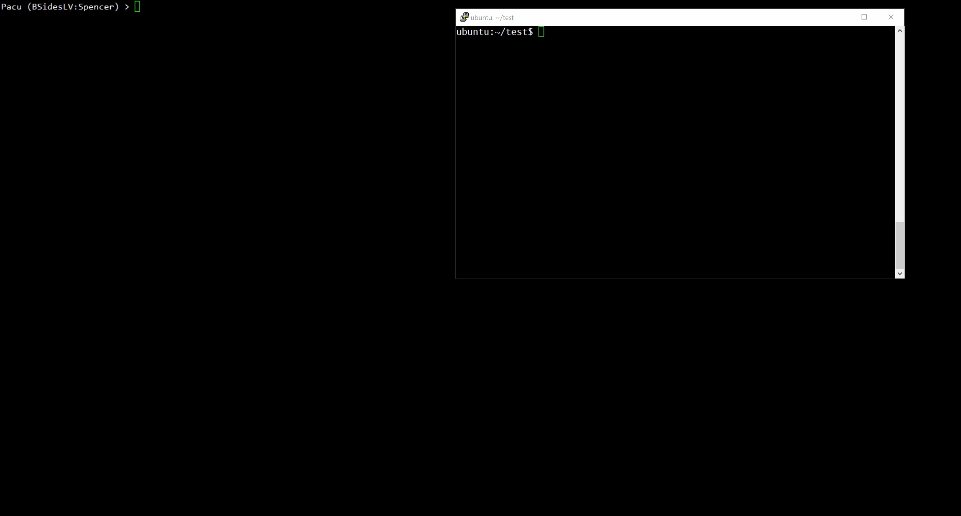

Slide 15
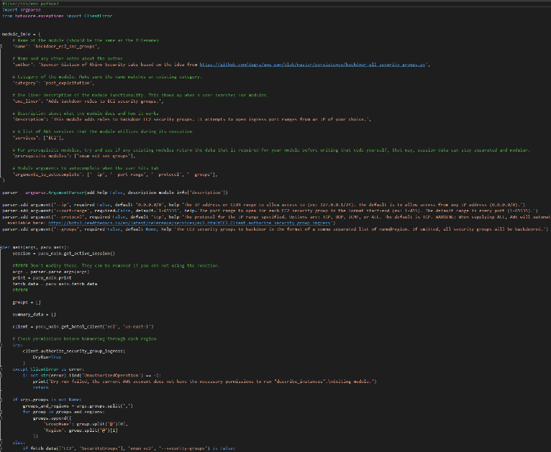
Pacu Development
Writing modules
Module template available as a starting point
Built-in API for the core Pacu functionality
get_regions()
get_boto3_client() / get_boto3_session()
key_info()
fetch_data()
print()
input()
Other database-related functions
Documentation and assistance through GitHub

Slide 16
Conclusion
What is the problem?
Lack of AWS attack tools
Lack of AWS security training and practice labs
How do we fix it?
CloudGoat and Pacu

Slide 17
Resources
Privilege Escalation Blog Post
https://rhinosecuritylabs.com/aws/aws-privilege-escalation-methods-mitigation/
Pacu Repo
https://github.com/RhinoSecurityLabs/pacu
CloudGoat Repo
https://github.com/RhinoSecurityLabs/cloudgoat
Email: spencer.gietzen@rhinosecuritylabs.com
Twitter: @SpenGietz @RhinoSecurity

